Slide 1

Software Process
Notes:
‹#›

Slide 2
Outline
Software Process Phases
Software Lifecycle Models
Build-and-Fix
Waterfall Model
Evolutionary Development
Iterative and Incremental
Spiral Model
Rational Unified Process (RUP)
Agile and Extreme Programming
Summary of the Pros and Cons of each model

Slide 3
Process Phases
Notes:
‹#›

Slide 4
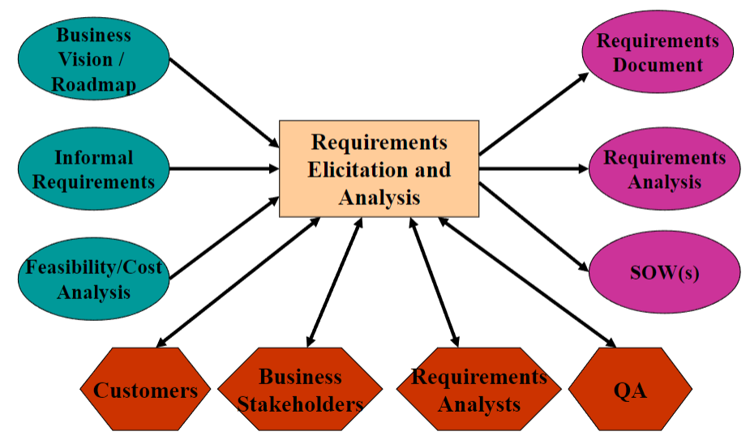
Software Process Flow (Very High Level)
Requirements:

Slide 5
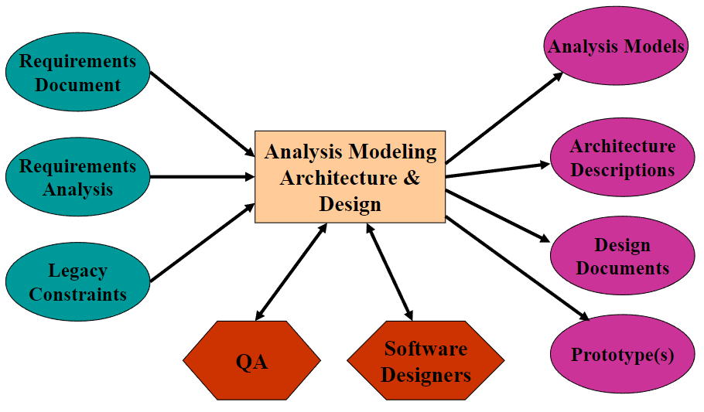
Software Process Flow (Very High Level)
Analysis Modeling, Architecture, and Design:

Slide 6
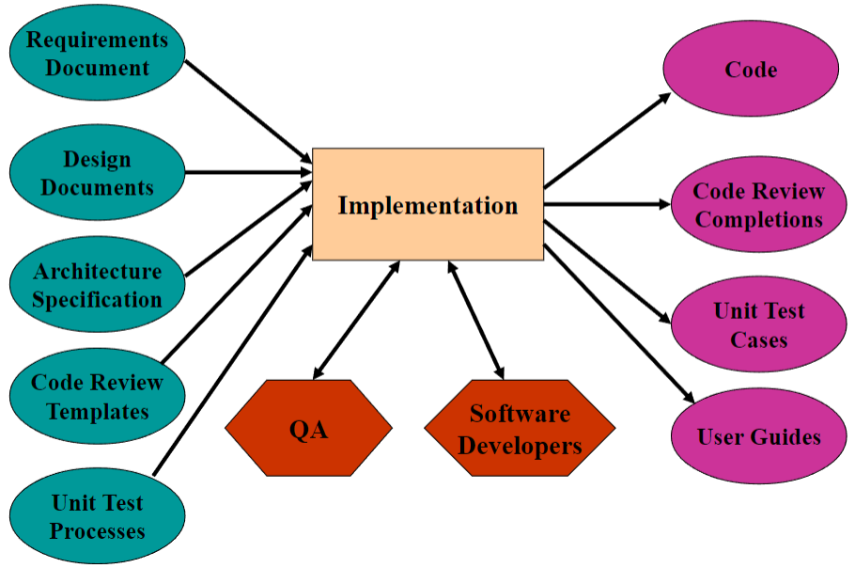
Software Process Flow (Very High Level)
Implementation Phase:

Slide 7
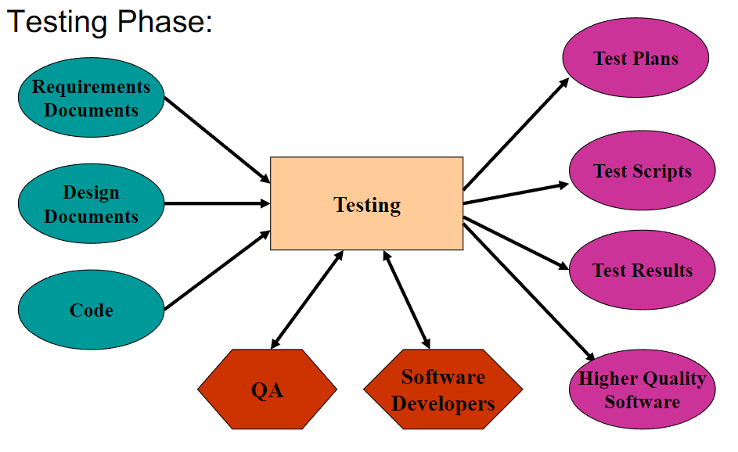
Software Process Flow (Very High Level)
Testing Phase:

Slide 8
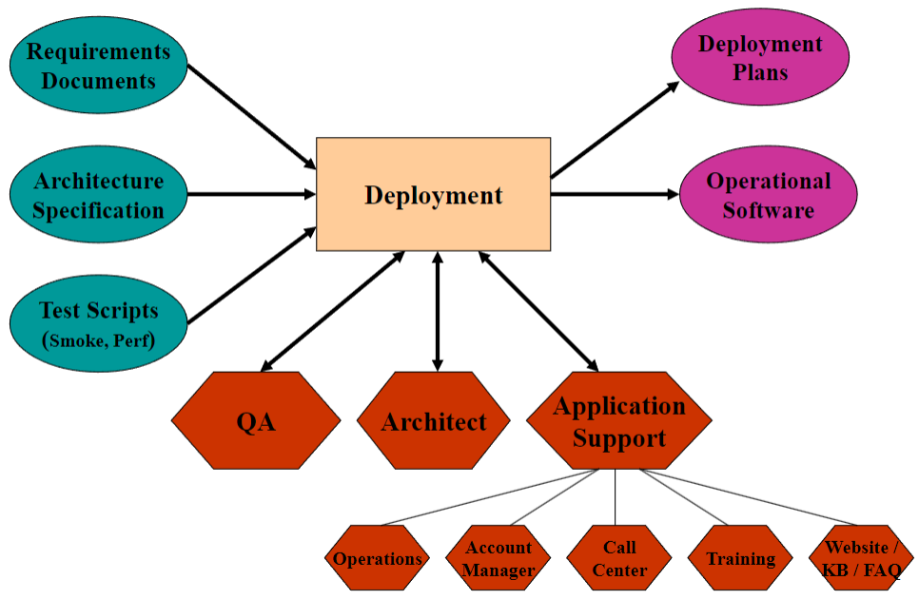
Software Process Flow (Very High Level)
Deployment:

Slide 9
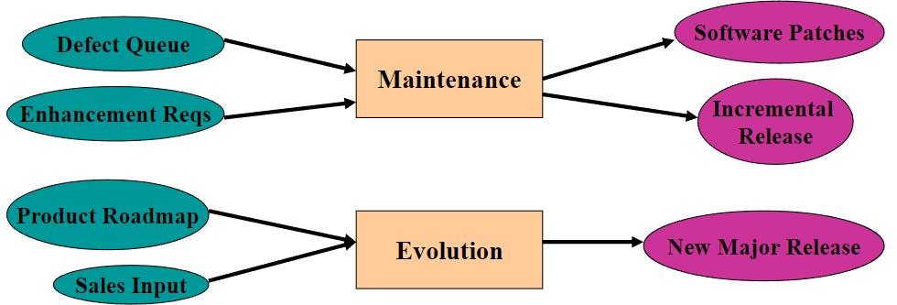
Maintenance and Evolution
Maintenance and Evolution are discussed often synonymously, but there are some key differences:
Maintenance: The ability to support the correct functionality of the current release of the system in the face of changes in requirements
Evolution: The ability to incorporate significant changes in product direction in the current architecture

Slide 10
Process Lifecycle Models
Notes:
‹#›

Slide 11
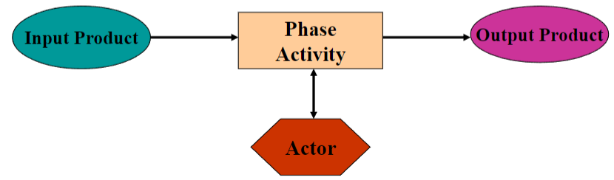
The Process Phases
How are the phases connected to each other?
Now that we have looked at each phase, what are the transitions between each phase?
What data is needed by each phase?
What data is produced by each phase?
Who are the players (actors) involved in each phase?
Given what we have covered in each phase, what is the lifecycle model that captures the software process?

Slide 12
The Generic Software Process Models
A quick list before we dig into details
Build-and-Fix
The “de facto” process
Waterfall Model
Distinct phases of specification, development, and testing
Evolutionary Development
Specification and development are interwoven
Iterative and Incremental
Iterate over the phases, build the system incrementally
Spiral Model
Risk management as a key phase in the process
RUP
Use-case driven development, architecture centric
Agile/XP
Embrace change, empower the people - code!

Slide 13
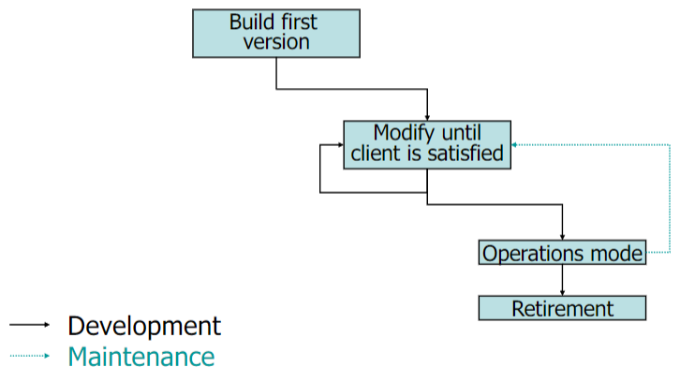
Build-and-Fix

Slide 14
Build-and-Fix: Pros and Cons
Pros:
No process overhead -> Programmers get to program!
Cons:
CHAOS!
Requirements may change, and even when they don’t, how do we track progress on them?
No quality management
No design documentation -> No sustainable architecture
Communication problems all over the place
Budget overruns -> product doesn’t meet expectations
Poor quality -> project (if not organizational) failure!
When to use:
When you have no other choice!

Slide 15
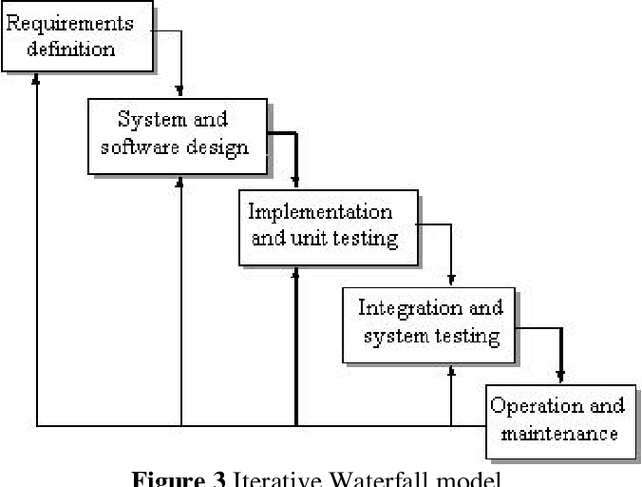
Waterfall Model

Slide 16
Waterfall: Pros and Cons
Pros:
Each Process phase is well defined
The input and output of each phase is also defined
Cons:
Inflexible partitioning of the project into distinct stages
Difficult to respond to changing customer requirements
Difficult to accommodate changes of any kind
Document-Centric
When to use:
This model is really only appropriate when the requirements are well defined and truly “frozen”
Also good for safety critical system where everything needs to be well defined and thoroughly tested
Healthcare Systems
Airplane Technology

Slide 17
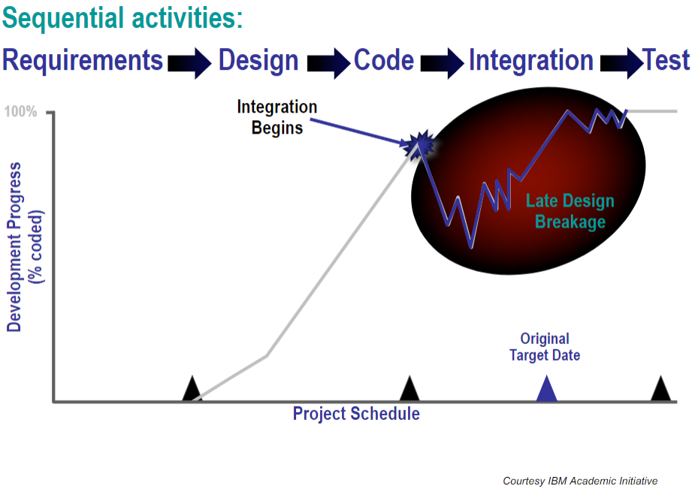
Waterfall: What Really Happens

Slide 18
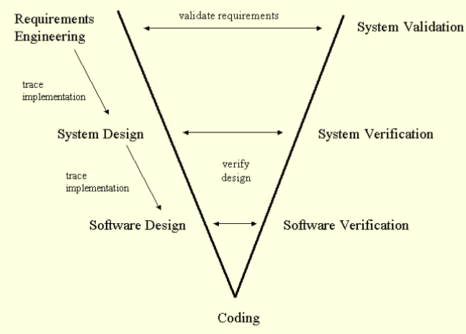
The V Model
This is an extension of the waterfall model with roots in the System Engineering process
Note:
Down the left side is a “waterfall”
The right side has parallel validation activities
Current recommended practice is to “chain” or “cycle” multiple V models

Slide 19
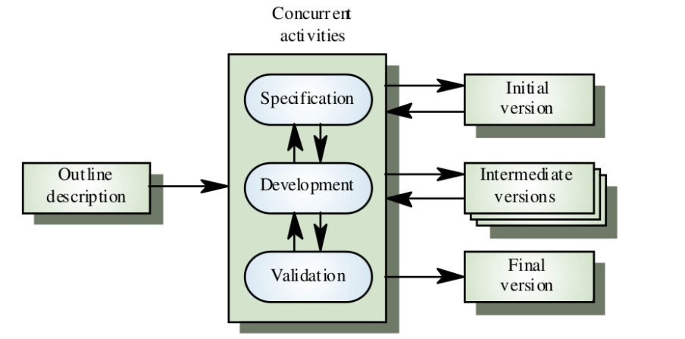
Evolutionary Development
The objective is to work with customers and to evolve a final system from an initial outline specification. This should start with a set of well-understood (but perhaps vague) requirements.

Slide 20
Evolutionary: Pros and Cons
Pros:
Work is not delayed by “thrashing around” in requirements
All roles are always engaged
Cons:
Lack of process visibility
Systems are often poorly structured
Special skills may be required (ie. rapid prototyping languages)
When to use:
For small or medium sized interactive systems
For parts of large systems (ie. the user interface)
For short lived or temporary systems (ie. research projects)

Slide 21
Process Iteration
Assumption:
Requirements ALWAYS evolve in the course of a project so process iteration where earlier stages are reworked is always part of the process for large systems
Iterative process models are considered the current “best practice” approaches for software development methodologies
Approaches that incorporate iteration:
Iterative and Incremental
Synchronize and Stabilize
Spiral Development
RUP
XP

Slide 22
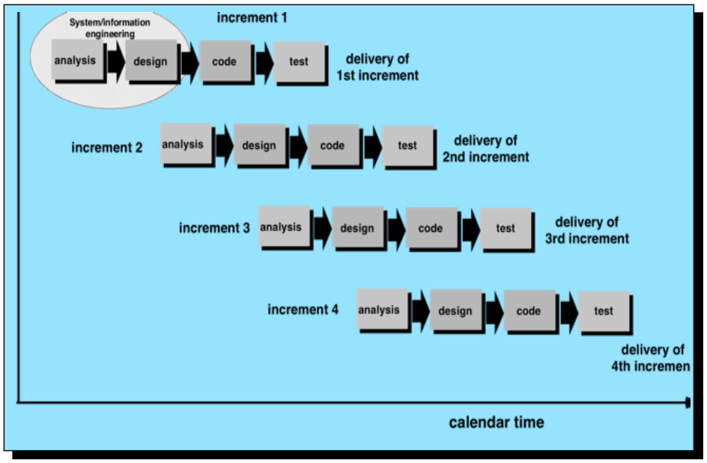
The Iterative and Incremental Model

Slide 23
The Iterative and Incremental Model
Delivery of the system is broken down into increments:
Not a single delivery
Each increment delivers part of the required functionality
Each increment may (in theory) use its own process model
User requirements are prioritized
Highest priority requirements done in the first increments
The rub - Users’ priorities may clash with architect’s
Once the development of an increment is started, the requirements are frozen for that iteration
Requirements for later increments can continue to evolve
However, in practice there is often significant scoping work needed in order to allow bidders to control risk

Slide 24
Iterative and Incremental: Pros and Cons
Pros:
Project is broken into smaller more manageable pieces
Easier to clarify requirements
Small teams may be used to address each increment
Cons:
Poor system architecture
“Narrow” prioritizing by the customer
Each increment evolves independently
Localizing requirements creep to a particular increment
“Big Bang” integration
What happens when increments don’t line up?
When to use:
When top-level requirements are properly partitioned
When a lot of outsourcing or “commercial off the shelf” solutions are being used

Slide 25
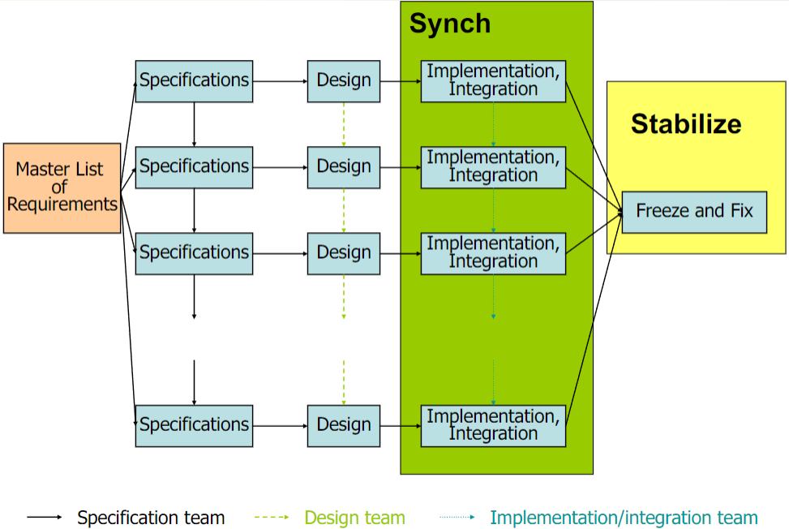
The Synchronize and Stabilize Model

Slide 26
Synchronize and Stabilize: Pros and Cons
Pros:
Customer value can be delivered with each increment
Early increments act as a prototype to help elicit requirements for later increments
Smaller teams can still be applied to each increment
The Key - communication flows into other increments!
Cons:
More complex to manage
“Ivory Tower” mentality
Requirements creep into earlier increments
Architectural complexity
When to use:
Medium-Large scale projects

Slide 27
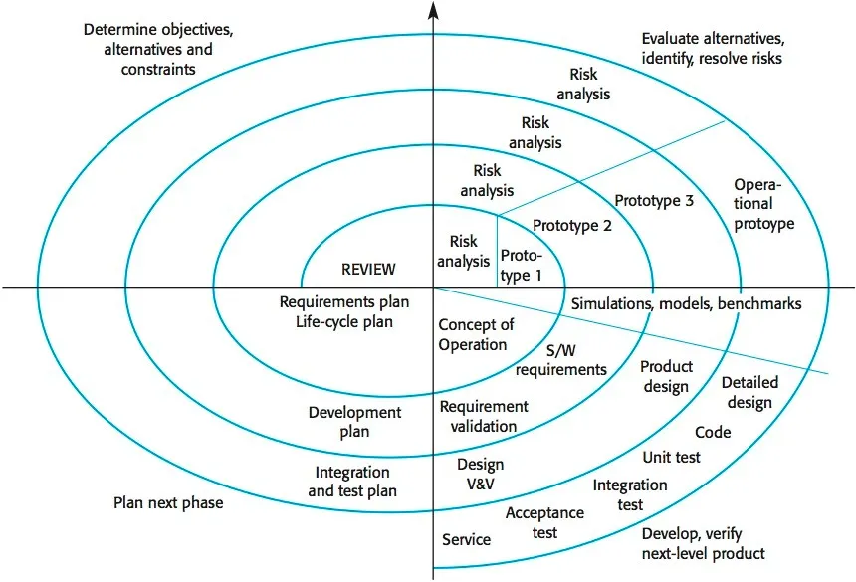
The Spiral Model

Slide 28
Spiral Model: Pros and Cons
Pros:
Each iteration should bring you closer to a finished product
Convergence
Risks are quickly identified and addressed
Provides a distinct communication point between engineers and managers
You can use any specific model in each “cycle”
Cons:
If you diverge from the plan, you start to “spiral” out of control!
When to use:
Large scale projects
Projects with a large amount of risk

Slide 29
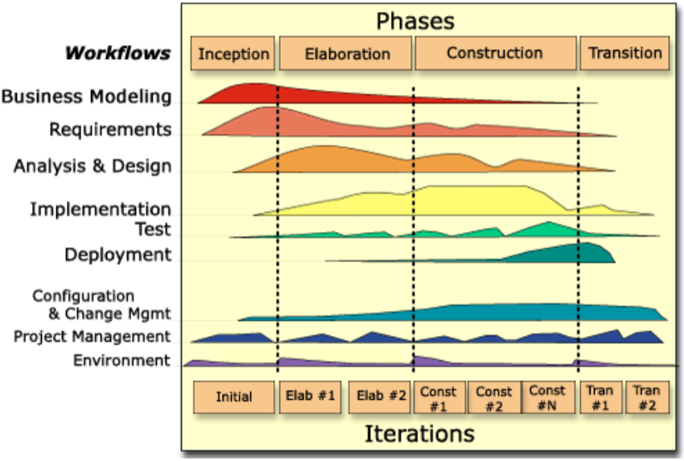
The Rational Unified Process Model

Slide 30
RUP Model: Pros and Cons
Pros:
Popular language (UML) and process model
Good tool support
Core workflow definitions and incorporation of business practices
Explicit recognition of deployment activities
Architecture centric or component based
Cons:
Some gaps or disconnects in the model
Pitched as an “all or nothing” process commercially
Tries to be all things to all people
When to use:
Suggested for medium to large scale projects

Slide 31
Agile Lifecycle Models
Notes:
‹#›

Slide 32
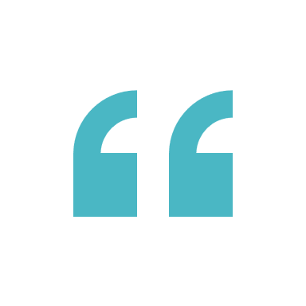
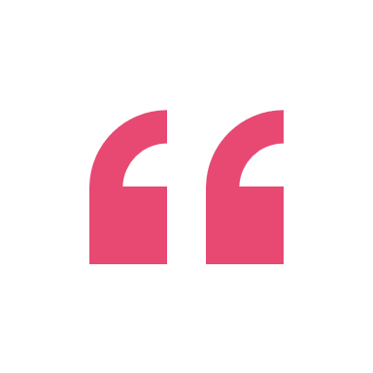


From “The Agile Manifesto”
The agile methodology movement is not anti-methodology; in fact, many of us want to restore credibility to the word. We also want to restore a balance: We embrace modeling, but not merely to file some diagram in a dusty corporate repository. We embrace documentation, but not to waste reams of paper in never-maintained and rarely-used tomes. We plan, but recognize the limits of planning in a turbulent environment…
- Fowler and Highsmith, Software Development Online, 8/01

Slide 33
More on Agile Thinking
You have probably heard of Agile as it is currently the “king” of software development processes
Agile methods refers to a collection of processes that incorporate the following principles they value as outlined in the manifesto:
“Individuals and interactions over processes and tools.
Working software over comprehensive documentation.
Customer collaboration over contract negotiation.
Responding to change over following a plan.”
Examples of agile methods include SCRUM and XP

Slide 34
Scrum
Scrum uses an Empirical Process control model instead of a Defined Process control model
Use the facts and evidence of how things are going to control the process rather than sticking to a predefined set of steps
Scrum terms:
Who’s Who: Scrum Master and Product Owner
What’s What: Product Backlog and Sprint Backlog
Why: The Sprint Goal
When: Daily Scrum, Sprint Planning, and Sprint Review
Where: Teams work together
Finally, How:
Sprint teams are completely empowered to do whatever they deem necessary to achieve the Sprint Goal

Slide 35
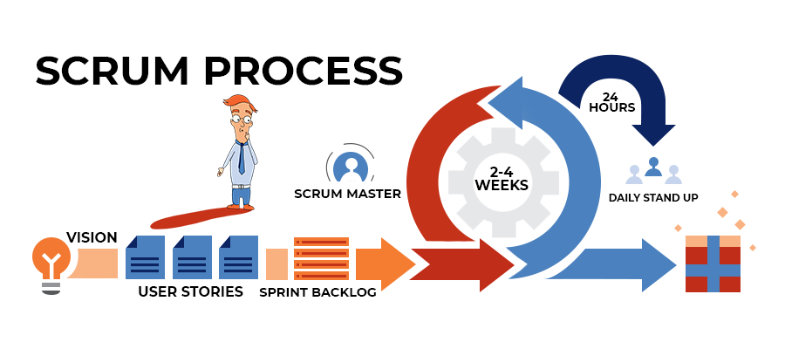
Scrum Visualized
From: https://kruschecompany.com/agile-software-development-with-scrum-framework/

Slide 36
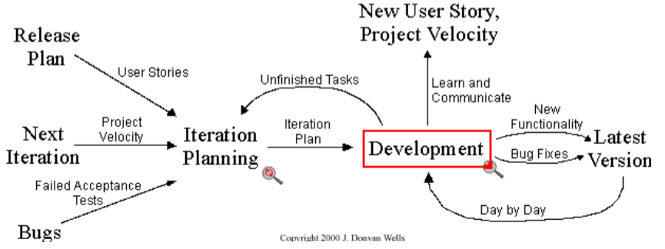
eXtreme Programming (XP)
One of the more popular Agile methodologies
For developers at least (more on this in the cons!)
There are four core principles driving XP:
Communication - always and constantly
Simplicity - do it the simple way now, don’t do a complicated thing that won’t be used for awhile
Feedback - get it from the customer and the team as often as possible
Courage - move fast and with confidence that you are doing the right thing

Slide 37
XP: Pros and Cons
Pros:
Let the coders code!
People-Centric - Is this a benefit?
Strong emphasis on the current best practices
Embraces change
Cons:
Relies on highly-skilled and experienced developers
Detractors say successful XP projects were successful because of the talent level of the people involved, not because of the process
A frustrating model to communicate to stakeholders
Business stakeholders want cost and schedule promises
When to use:
On fast and light projects that must react to change
When you have an experienced development team

Slide 38
A Final Comparison
Model | Strengths | Weaknesses
Build-and-Fix | Fine for small programs that do not require much maintenance | Totally unsatisfactory for non trivial programs
Waterfall | Disciplined Approach Document Driven | Delivered product may not meet clients needs
Incremental | Manageable increments User sees end functionality sooner | Architecture mismatch Lack of communication
Synchronize and Stabilize | Requirements change is manageable Ensures components can be successfully integrated | Complex to manage Complex to architect
Spiral | Incorporates features of all the above models Global view always revisited | Can be used only for large scale products Engineers have to be competent at risk analysis
RUP | Incorporates current process thinking Strong tool support Recognizes deployment | Commercially driven All things to all people
Agile/XP | Light process that “stays out of the way” Recognize and embrace change | Scalability is a question Relies on experienced developers

